Slide 1
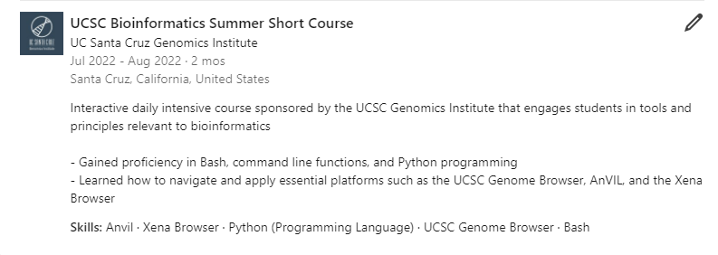
BSSC LinkedIn Description
Notes
Use past-tense when describing
Don’t write too much, summarize in 2-3 bullets

